Slide 1
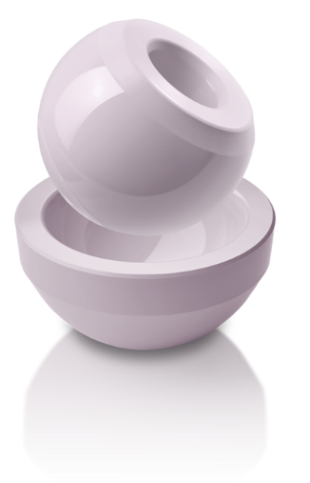
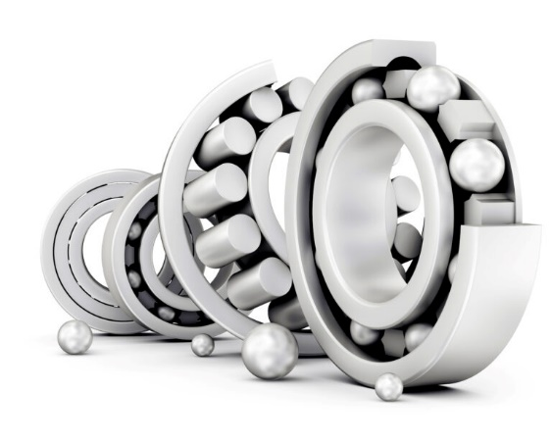
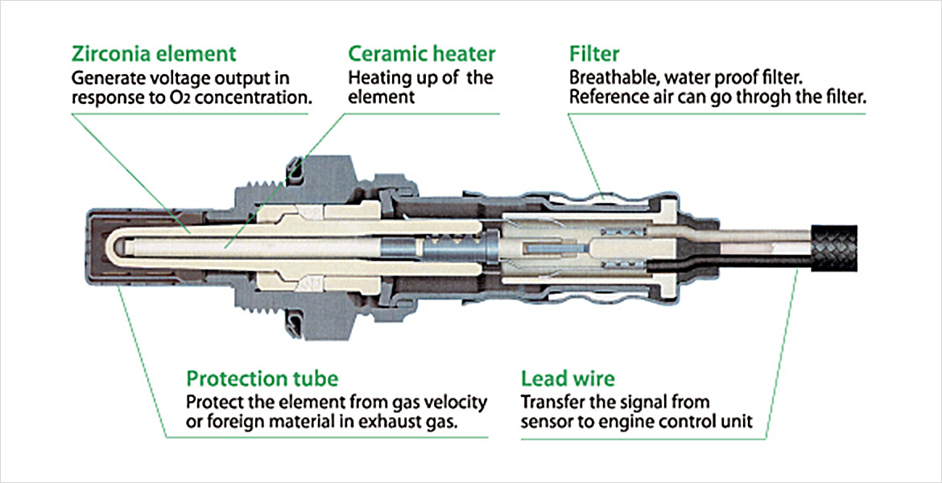
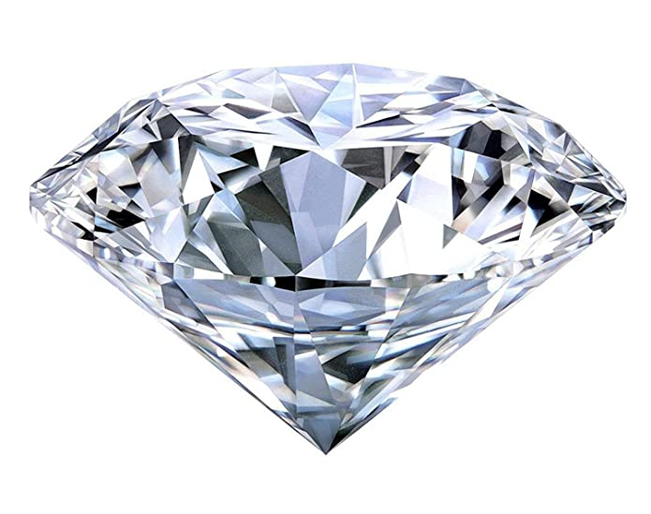
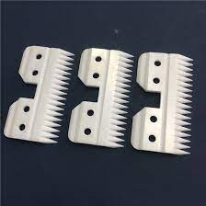
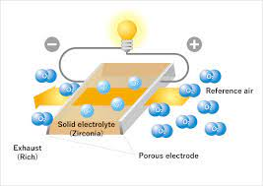
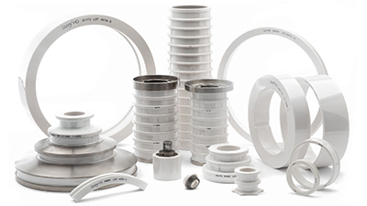
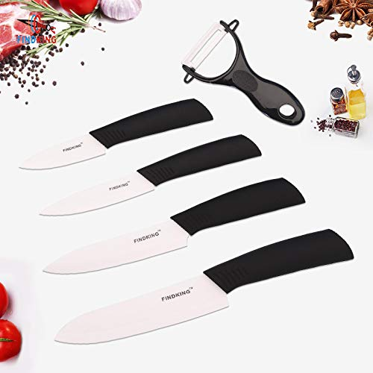
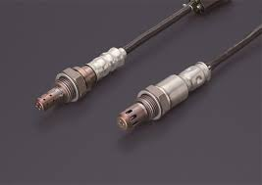
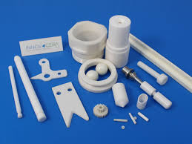
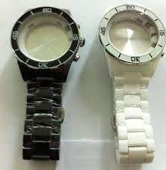
Applications of Zirconia (ZrO2) based Ceramics
All of these are made starting from zirconia powders

Slide 2
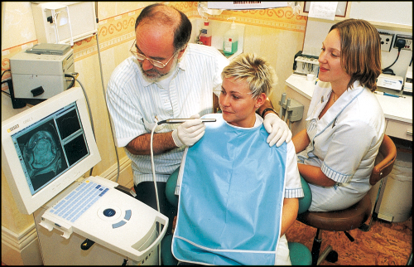
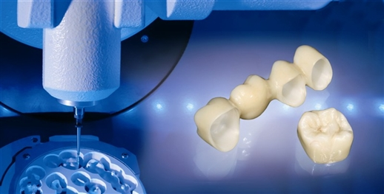
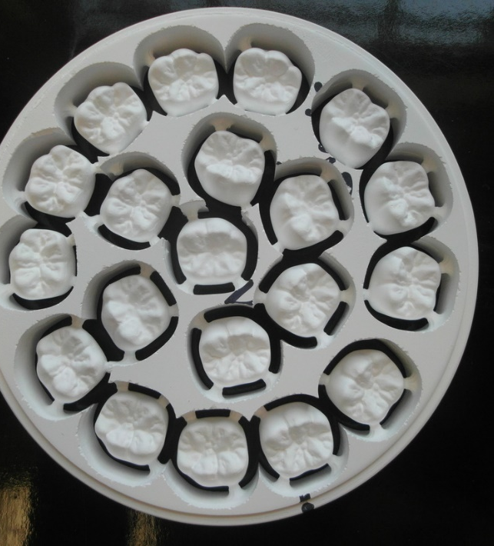
Zirconia nanopowder / disks for Dental Crowns
Zirconia Dental Crowns possess
Superior aesthetics – like natural
Highest strength and
High fracture toughness
Zirconia disks require special quality zirconia nanopowder
Dental crowns are fabricated by the dental labs from the zirconia disks using CAD-CAM followed by heat treatment

Slide 3
There is currently no manufacturer of the raw material in India. World leader in the segment is TOSOH, Japan
The market for ceramic crowns in India particularly zirconia crowns is large owing to the needs of the population
For example, Import of Zirconia disks (a single premium brand): Rs. 6 Crores / year
The total market for ceramic dental crowns is estimated to be around Rs. 30 – 50 Crores (All Imported)
Key Product Determining Factor
Powder with tightly controlled powder characteristics

Slide 4
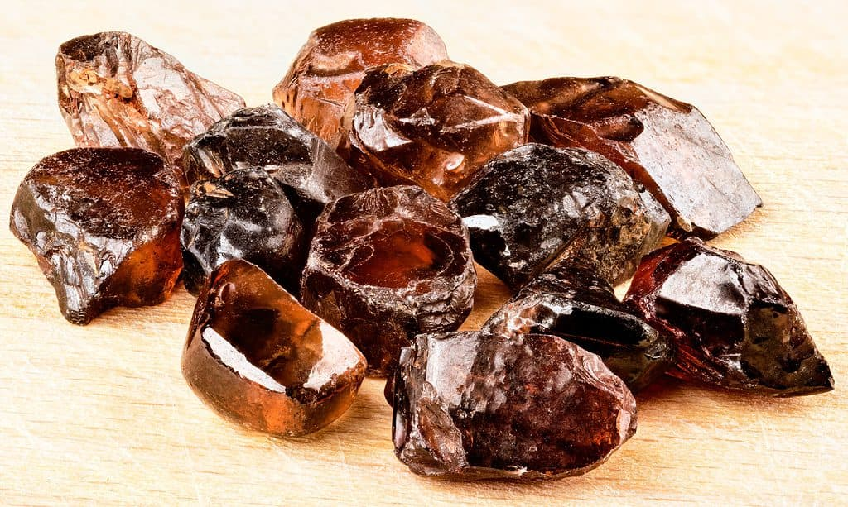
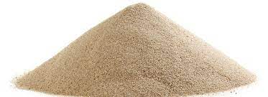
Zircon (ZrSiO₄) – The source for ZrO₂
Zircon is believed to be the oldest existing mineral on our planet with zircon being formed at the beginning of the solar system some 4.5 billion years ago.
It is the ability of zircon to withstand high temperatures and chemical attack that means they are found in some of the earliest rocks on our planet.
The durability of Zircon means it remains in heavy sedimentary deposits such as beach sands.
http://www.zircomet.com/sec/11114/Zircon-Resources/
https://a-z-animals.com/blog/the-oldest-mineral-found-on-earth/

Slide 5
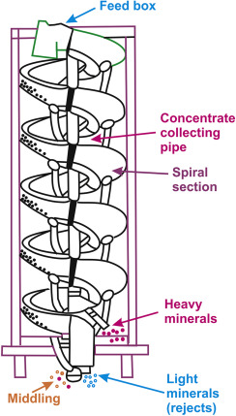
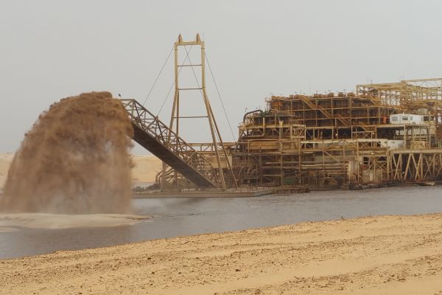
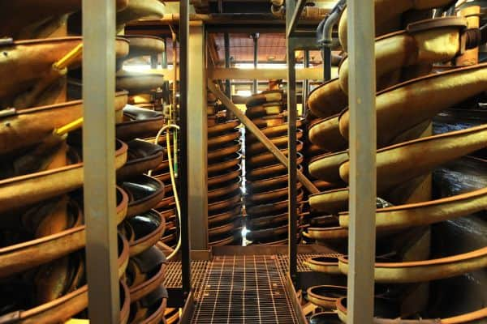
Zirconia (ZrO₂) from Zircon (ZrSiO₄)
Dry mining is suitable where deposits are shallow. The ore is conveyed to a wet concentrator plant, by slurry pipeline or overland conveyor.
Dredge mining is best suited to ore reserves below the water table. Dredges mine in artificial ponds, pumping ore in slurry form to a floating concentrator.
Wet concentrator plants are designed to produce a high grade of heavy mineral concentrate (about 98% heavy mineral content). The ore is washed through a series of spiral separators to separate the heavy mineral sands from the lighter quartz and clay impurities.
As larger and heavier particles sink to the bottom of the sluice faster and experience more drag from the bottom, they travel slower, and so move toward the center of the spiral. Conversely, light particles stay toward the outside of the spiral, with the water, and quickly reach the bottom
https://www.zircon-association.org/zircon-sand.html
https://www.sciencedirect.com/topics/earth-and-planetary-sciences/spiral-concentrators

Slide 6
Zirconia (ZrO₂) from Zircon (ZrSiO₄)
Various methods of decomposition have been investigated owing to the different levels of purity required and the cost of manufacture. All these methods have three steps in common.
Firstly, zircon is decomposed or dissociated by chemical, thermal or mechano-chemical means. Secondly, the products obtained are treated by solubility differentiation. Thirdly, the zirconium compounds are isolated from the residual impurities
Thermal Dissociation
The dissociation reaction is conducted in an arc plasma furnace that forms zirconia in droplets of silica.
To avoid recombination or to reduce it to minimum levels, the mixture must be quenched rapidly.
As a result, it produces crystals of zirconium oxide in amorphous silica.
Further leaching with sulphuric acid is necessary to produce a zirconium sulphate solution and insoluble silica.
For leaching, sodium hydroxide can also be used. In this case, aqueous sodium silicate and zirconia are obtained. Sodium silicate is a useful by-product, which therefore can be commercialised. This process is environmentally friendly
Zirconium Chemicals, University of Pretoria, Chapter 5

Slide 7
Decomposition by Fusion
The fusion procedure is very common in the recovery of zirconia from zircon sands. In this procedure, different materials such as sodium hydroxide, sodium carbonate and calcium carbonate can be used.
Fusion is conducted at 650°C with a slight excess of sodium hydroxide. Products of fusion obtained are sodium zirconate and sodium metasilicate or orthosilicate, depending on the mole ratios of alkali.
The cooled reaction products are crushed and leached with water. As a result, sodium metasilicate is dissolved and sodium zirconate is hydrolysed to hydrous zirconia. Hydrous zirconia is insoluble and is recovered by filtration.
ZrSiO₄ + 4NaOH → Na₂ZrO₃ + Na₂SiO₃ + 2 H₂O
ZrSiO4+ 6NaOH → Na₂ZrO₃ + Na₄SiO₄ + 3 H₂O
Na₂ZrO₃ + XH₂O → NaOH(aq) + ZrO₂.xH₂O
Chlorination: American and French zirconium metal producers are using this process. Chlorine is used as a fluidising gas and the reaction is endothermic.
The energy required for the process is supplied via induction heating of the internal graphite walls of the chlorinator. The reaction takes place at 1100°C.
The gases produced, consisting of zirconium tetrachloride, silicon tetrachloride and carbon monoxide, are cooled down to 200ºC.
ZrSiO₄ + 4Cl₂ + 4C → ZrCl₄ + SiCl₄ + CO
Zirconium Chemicals, University of Pretoria, Chapter 5

Slide 8
During the first cooling, zirconium tetrachloride, containing hafnium as impurity, is collected as a powder.
Silicon tetrachloride is condensed following further condensation and is subsequently purified and used to produce fumed silica, fused quartz and fused quartz optical fibre.
Zirconium tetrachloride can be converted to oxychloride with water. Zirconium oxychloride can be crystallised by cooling the solution to 20°C. This step allows major impurities to be separated out. The crystals can then be calcined to zirconia
Zirconium Chemicals, University of Pretoria, Chapter 5

Slide 9
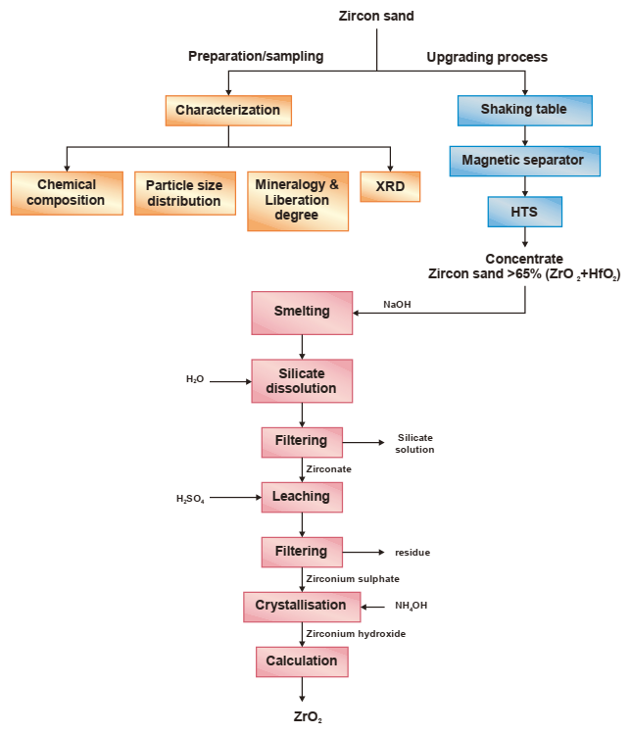
High Tension Separator
Calcination

Slide 10
Synthesis of Zirconia Powder (3 mole % Y₂O₃ Doped) by Co-precipitation
Y₂O₃ + HNO₃
+
ZrOCl₂.8H₂O + H₂O
Mixture nitrate & oxychloride solution
+
NH₄OH
As-synthesized precipitate
Washing, Drying & Calcination

Slide 11
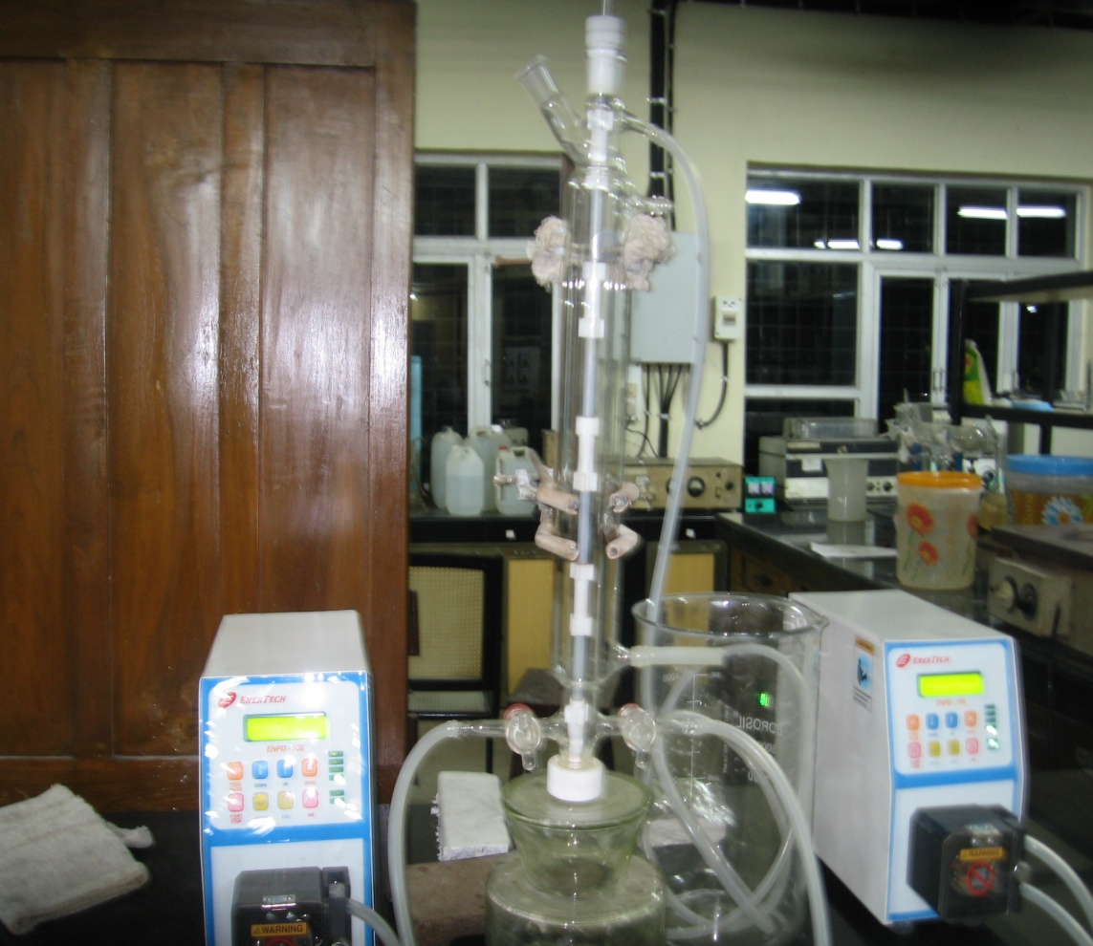
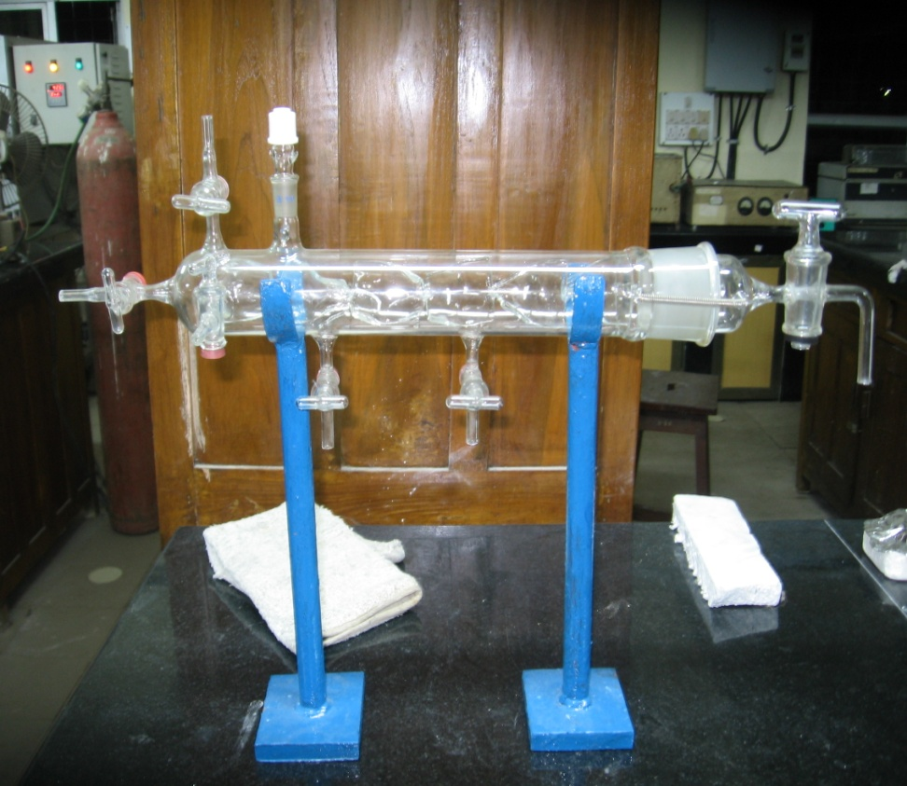
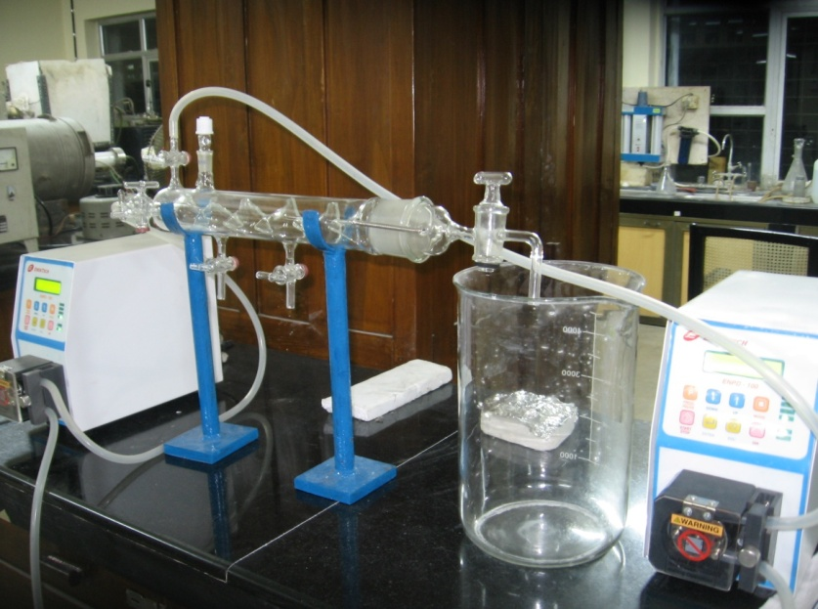
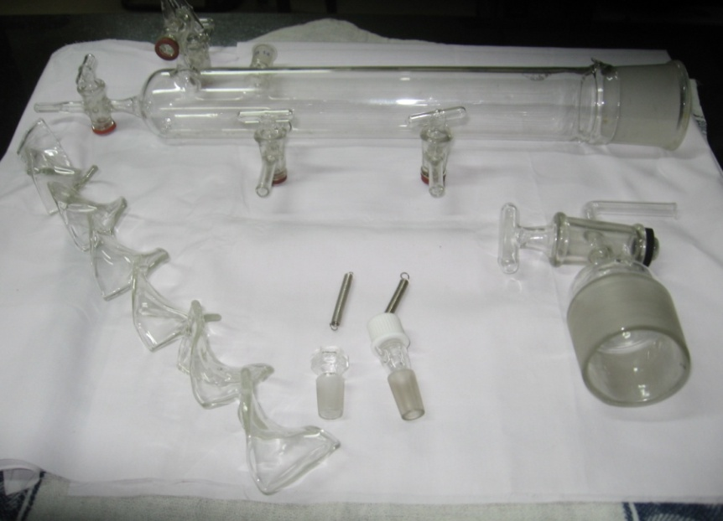
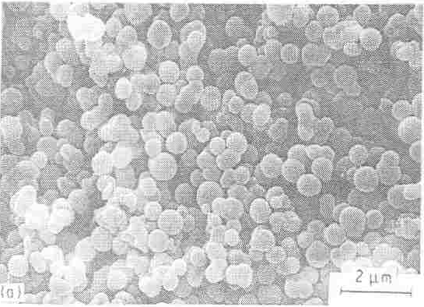
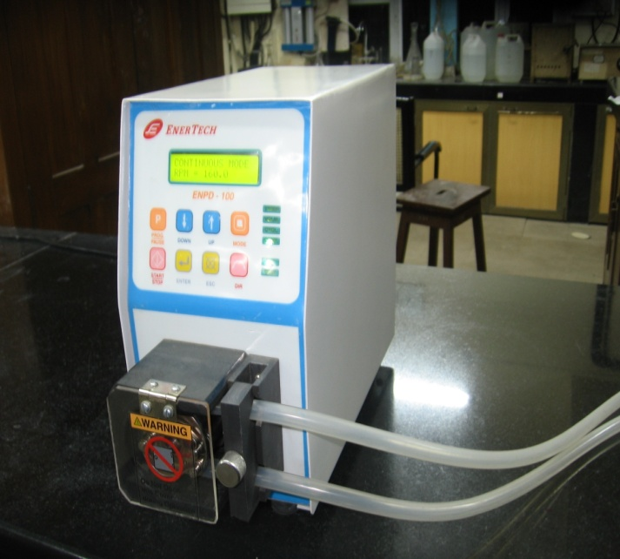
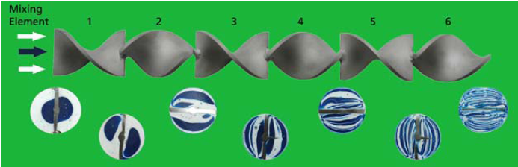
Continuous Reactors Used
Tubular Reactor equipped with Static Mixer
Unassembled Parts
Reactor Set-up
Flow with Static Mixer
Tubular
Reactor
Static
Mixer
Peristaltic Pump for solutions
Collection Jar
Notes:
11

Slide 12
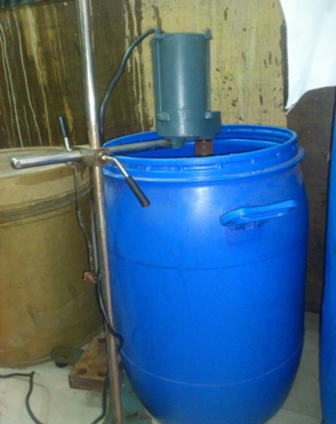
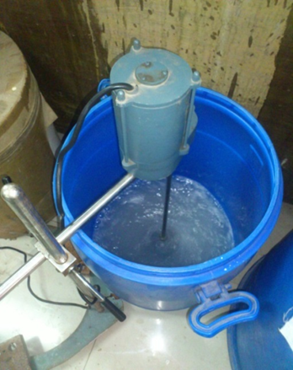
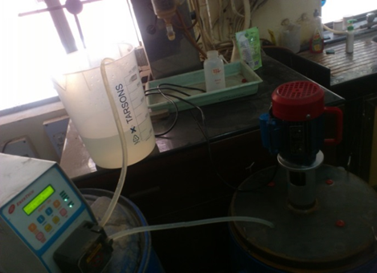
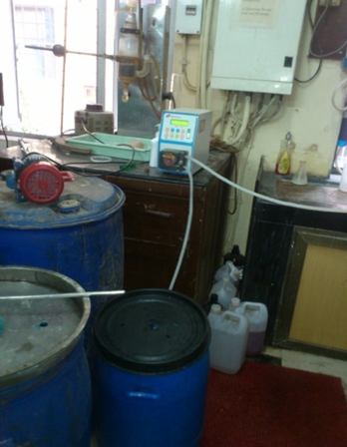
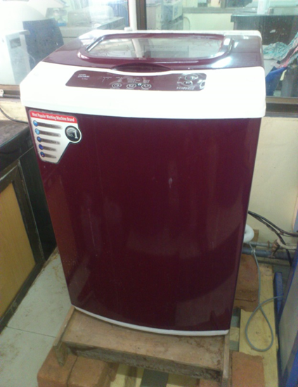
Synthesis and washing of nanoparticles
 | 1kg/week (3YSZ) | 20kg overall |  | 1kg/week
Reagent | Quantity | Quantity |  | Volume
Zr-oxychloride solution (0.5M) | 4.5 kg | 90 kg |  | 22.4 litres
Yttrium nitrate solution (0.2M) | 65gm | 1.3 kg |  | 1800 ml
Ammonia soln | 35 litres | 700 litres |  | 33.6 litres
Distilled water | 560 litres | 11200 litres |  | 560 litres
Zirconium oxychloride solution mixing
Drum mixer and reaction vessel
Washing machine used for recovery

Slide 13
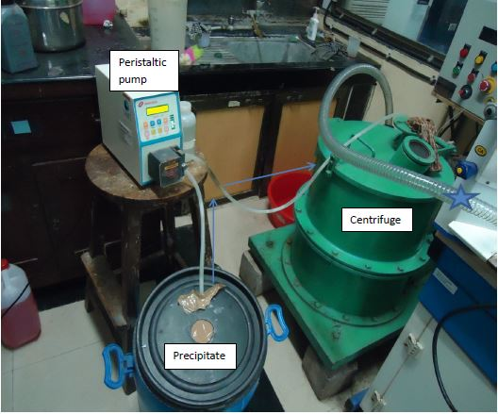
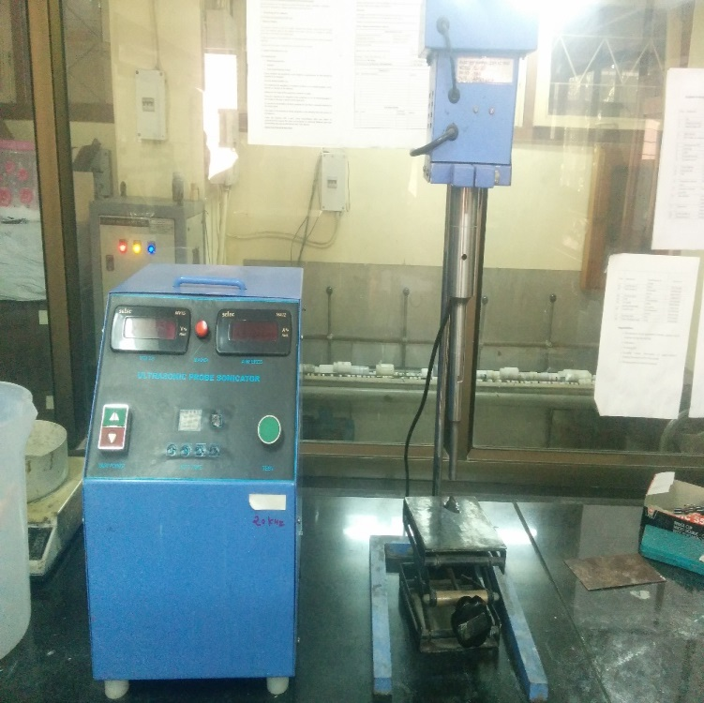
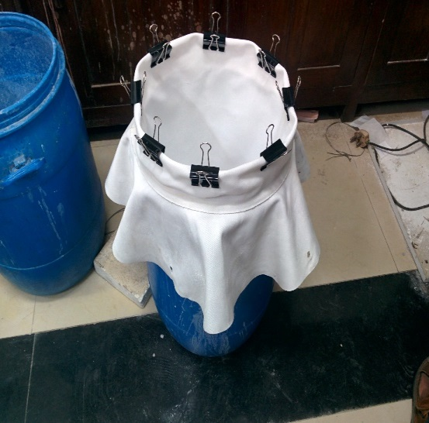
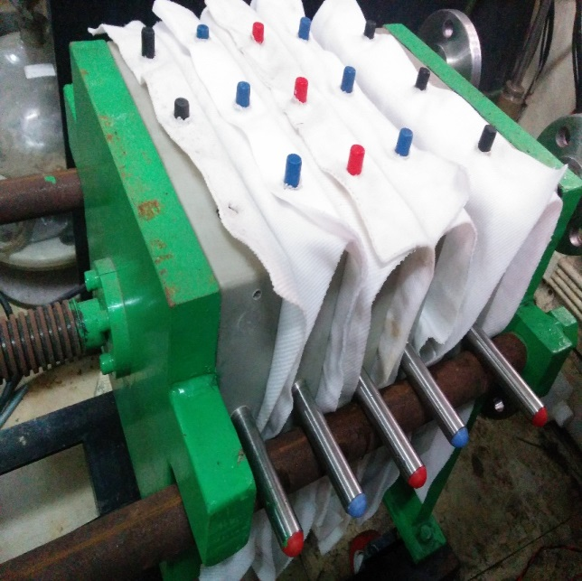
Synthesis and washing of nanoparticles

Slide 14
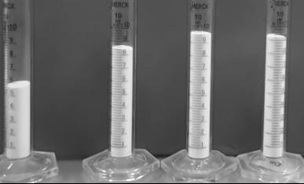
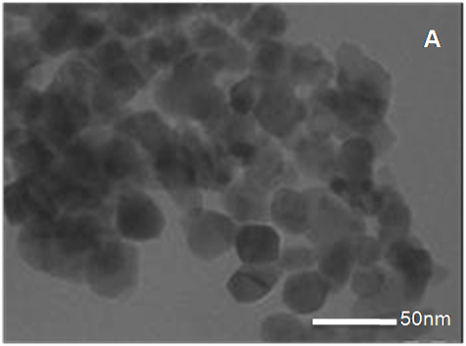
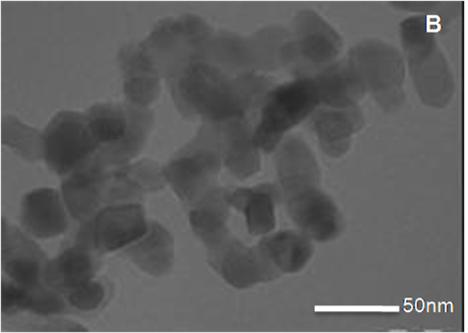
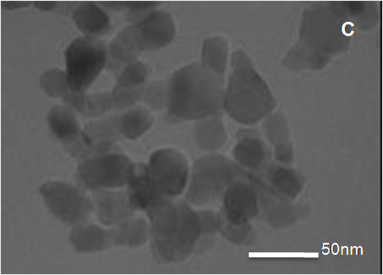
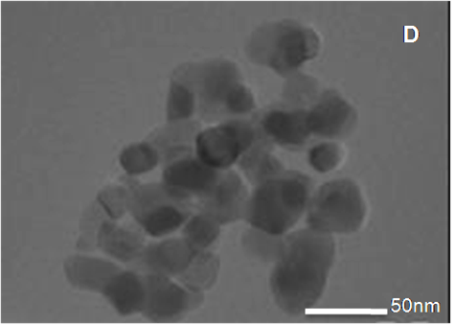
Coprecipitated 3YSZ powders calcined at 900°C
A
B
C
D
A
B
C
D

Slide 15
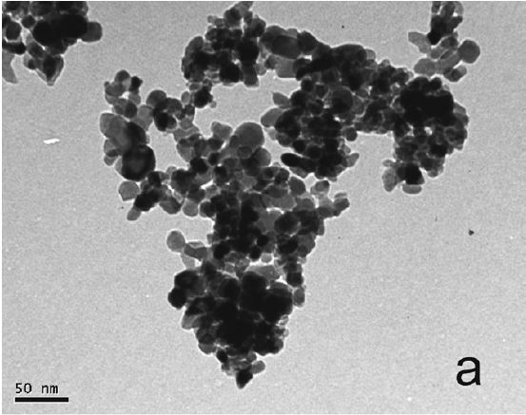
FEG-TEM
Commercial powder
First batch
Second batch

Slide 16
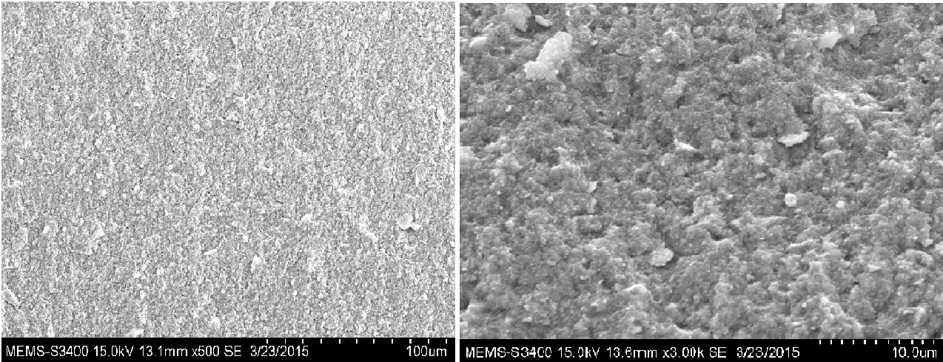
Microstructure of uniaxially pressed green body fracture at 2.5 ton/cm² (~250 MPa)
Granules were broken and merged into a homogeneous structure

Slide 17
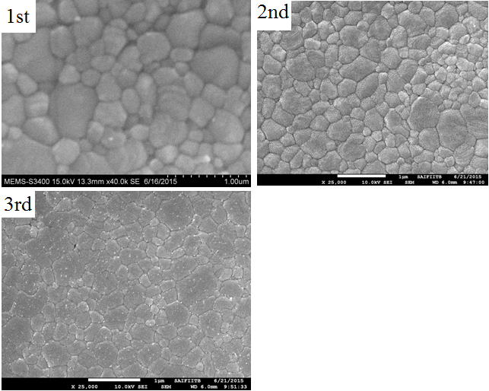
Grain Sizes of the samples sintered at 1300⁰C

